Slide 1

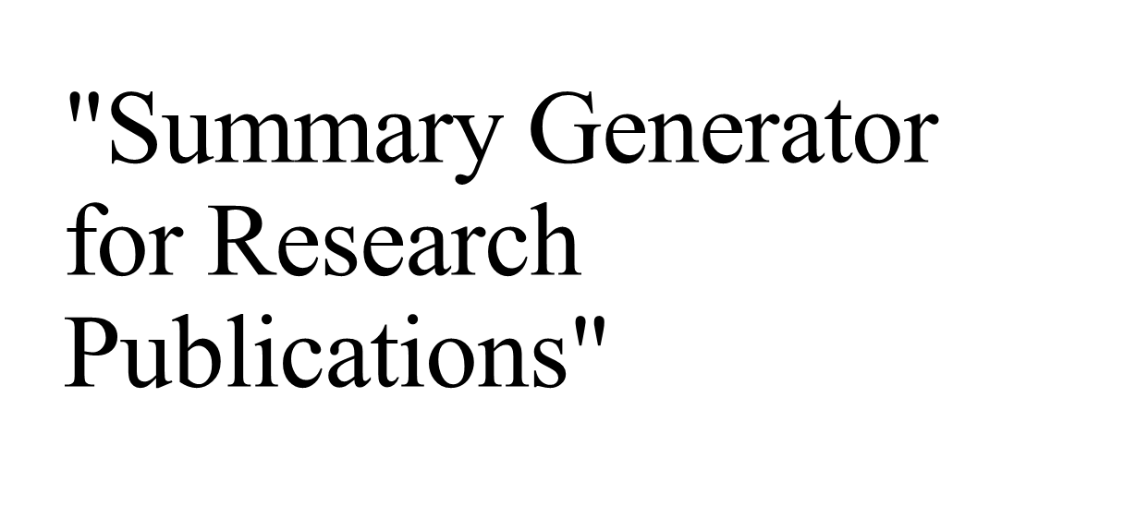
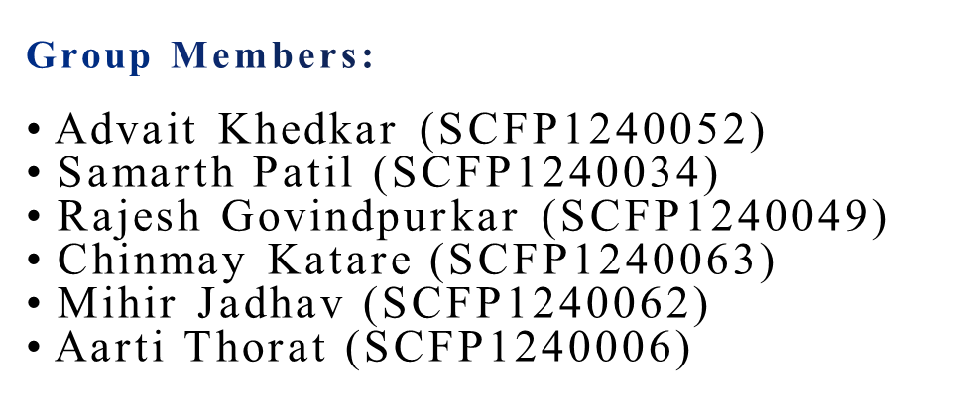

Slide 2
Introduction:
Importance of academic achievements in institutional accreditation.
Challenges of manual publication summaries:
  Time-consuming.
  Error-prone.
Solution: Automated summary generation using NLP and database integration.

Slide 3
Problem Statement:
Faculty members face challenges in creating structured publication profiles.
Manual efforts are inefficient and error-prone.
The increasing volume of research demands concise and accurate summaries.

Slide 4
Project Objective:
1.Automate Publication Record Collection:
Develop a system that automatically collects publication records from popular academic
databases
(e.g., Google Scholar, DBLP, Scopus) to save time and effort for faculty members.
2. Organize Publications by Year and Type:
Categorize the publications by their respective years and types (e.g., journals, conferences,
books) to create a structured and easily accessible record for each faculty mem ber.

Slide 5
3. Support Custom Date-Range Queries:
Enable the user to specify custom date ranges to filter and display publications from specific periods, facilitating more accurate and personalized reporting.

Slide 6
System Architecture:
Overview of modules:
Data Fetching
Data Processing
Report Generation
Tools and technologies:
Google Scholar API, DBLP API Scholarly LY.

Slide 7
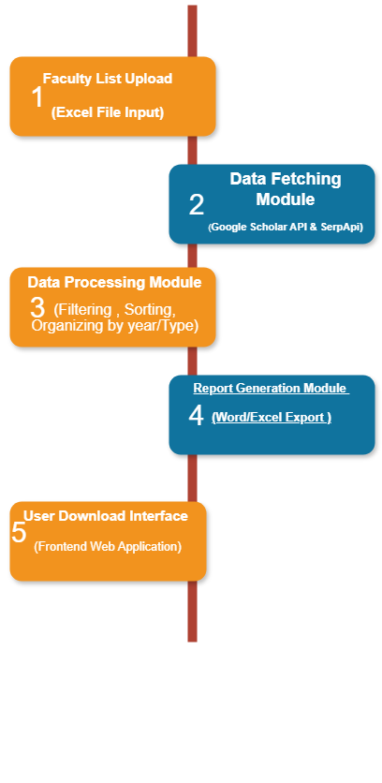

Slide 8
System Overview:
The system automates fetching, organizing, and generating publication summaries from academic databases such as Google Scholar and DBLP using APIs. It processes input from an Excel sheet and exports reports.

Slide 9


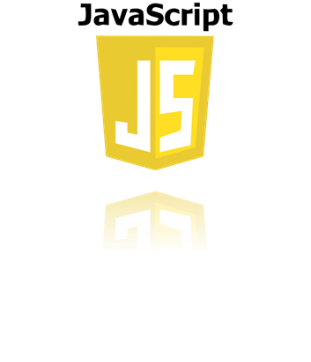


Technologies Used:
Back-end: Python (Flask), BeautifulSoup, Pandas.
Front-end: HTML, CSS, JavaScript.
APIs for data and processing.

Slide 10
Implementation Highlights:
  Front-end
    Responsive and interactive user interface.
Back-end
  Efficient crawling, categorization, and report generation.
SerpApi
It is a vital tool for facilitating efficient and automated data fetching from academic sources like Google Scholar and DBLP.

Slide 11
Conclusion:
Simplifies academic profile creation.
Enhances efficiency and reduces errors.
Potential for future expansion to support more databases and advanced summarization techniques.

Slide 12
RESEARCH AND REFERENCES:
Details/Links of reference:
Web Scraping And Data Acquisition Using Google Scholar.
Retrieving technology infrastructure using Google scholar and APIs.
https://scholar.google.com/
https://serpapi.com/google-scholar-api

Slide 13
Thank you

